Slide 1
Welcome to Academy Cloud Architecting
Notes:
Academy Cloud Architecting covers the fundamentals of building IT infrastructure on Amazon Web Services, or AWS. The course is designed to teach solutions architects how to optimize the use of the AWS Cloud by understanding AWS services and how these services fit into cloud-based solutions. Because architectural solutions can differ depending on industry, type of applications, and size of business, this course emphasizes best practices for the AWS Cloud, and it recommends various design patterns to help you think through the process of architecting optimal IT solutions on AWS. It also presents case studies throughout the course, which showcase how some AWS customers have designed their infrastructures, and the strategies and services that they implemented. Finally, this course also provides opportunities to build a variety of infrastructures via a guided, hands-on approach.

Slide 2
What’s In This Module?
Prerequisites
Course Objectives
Course Overview
Notes:
This module lists the prerequisites for the course and it reviews the course objectives. It also provides an overview of the topics covered in each of the modules in the course.

Slide 3

Prerequisites
Preferred knowledge
Completion of Academy Cloud Foundations (ACF) or equivalent experience.
Working knowledge of distributed systems.
Familiarity with general networking concepts.
Working knowledge of multi-tier architectures.
Familiarity with cloud computing concepts.
Notes:
Let’s start with a review of the prerequisites for this course.
To ensure success in this course, it is preferred that you have:
• Completed the Academy Cloud Foundations (ACF) course or have equivalent experience
• A working knowledge of distributed systems
• Familiarity with general networking concepts
• A working knowledge of multi-tier architectures
• Familiarity with cloud computing concepts

Slide 4
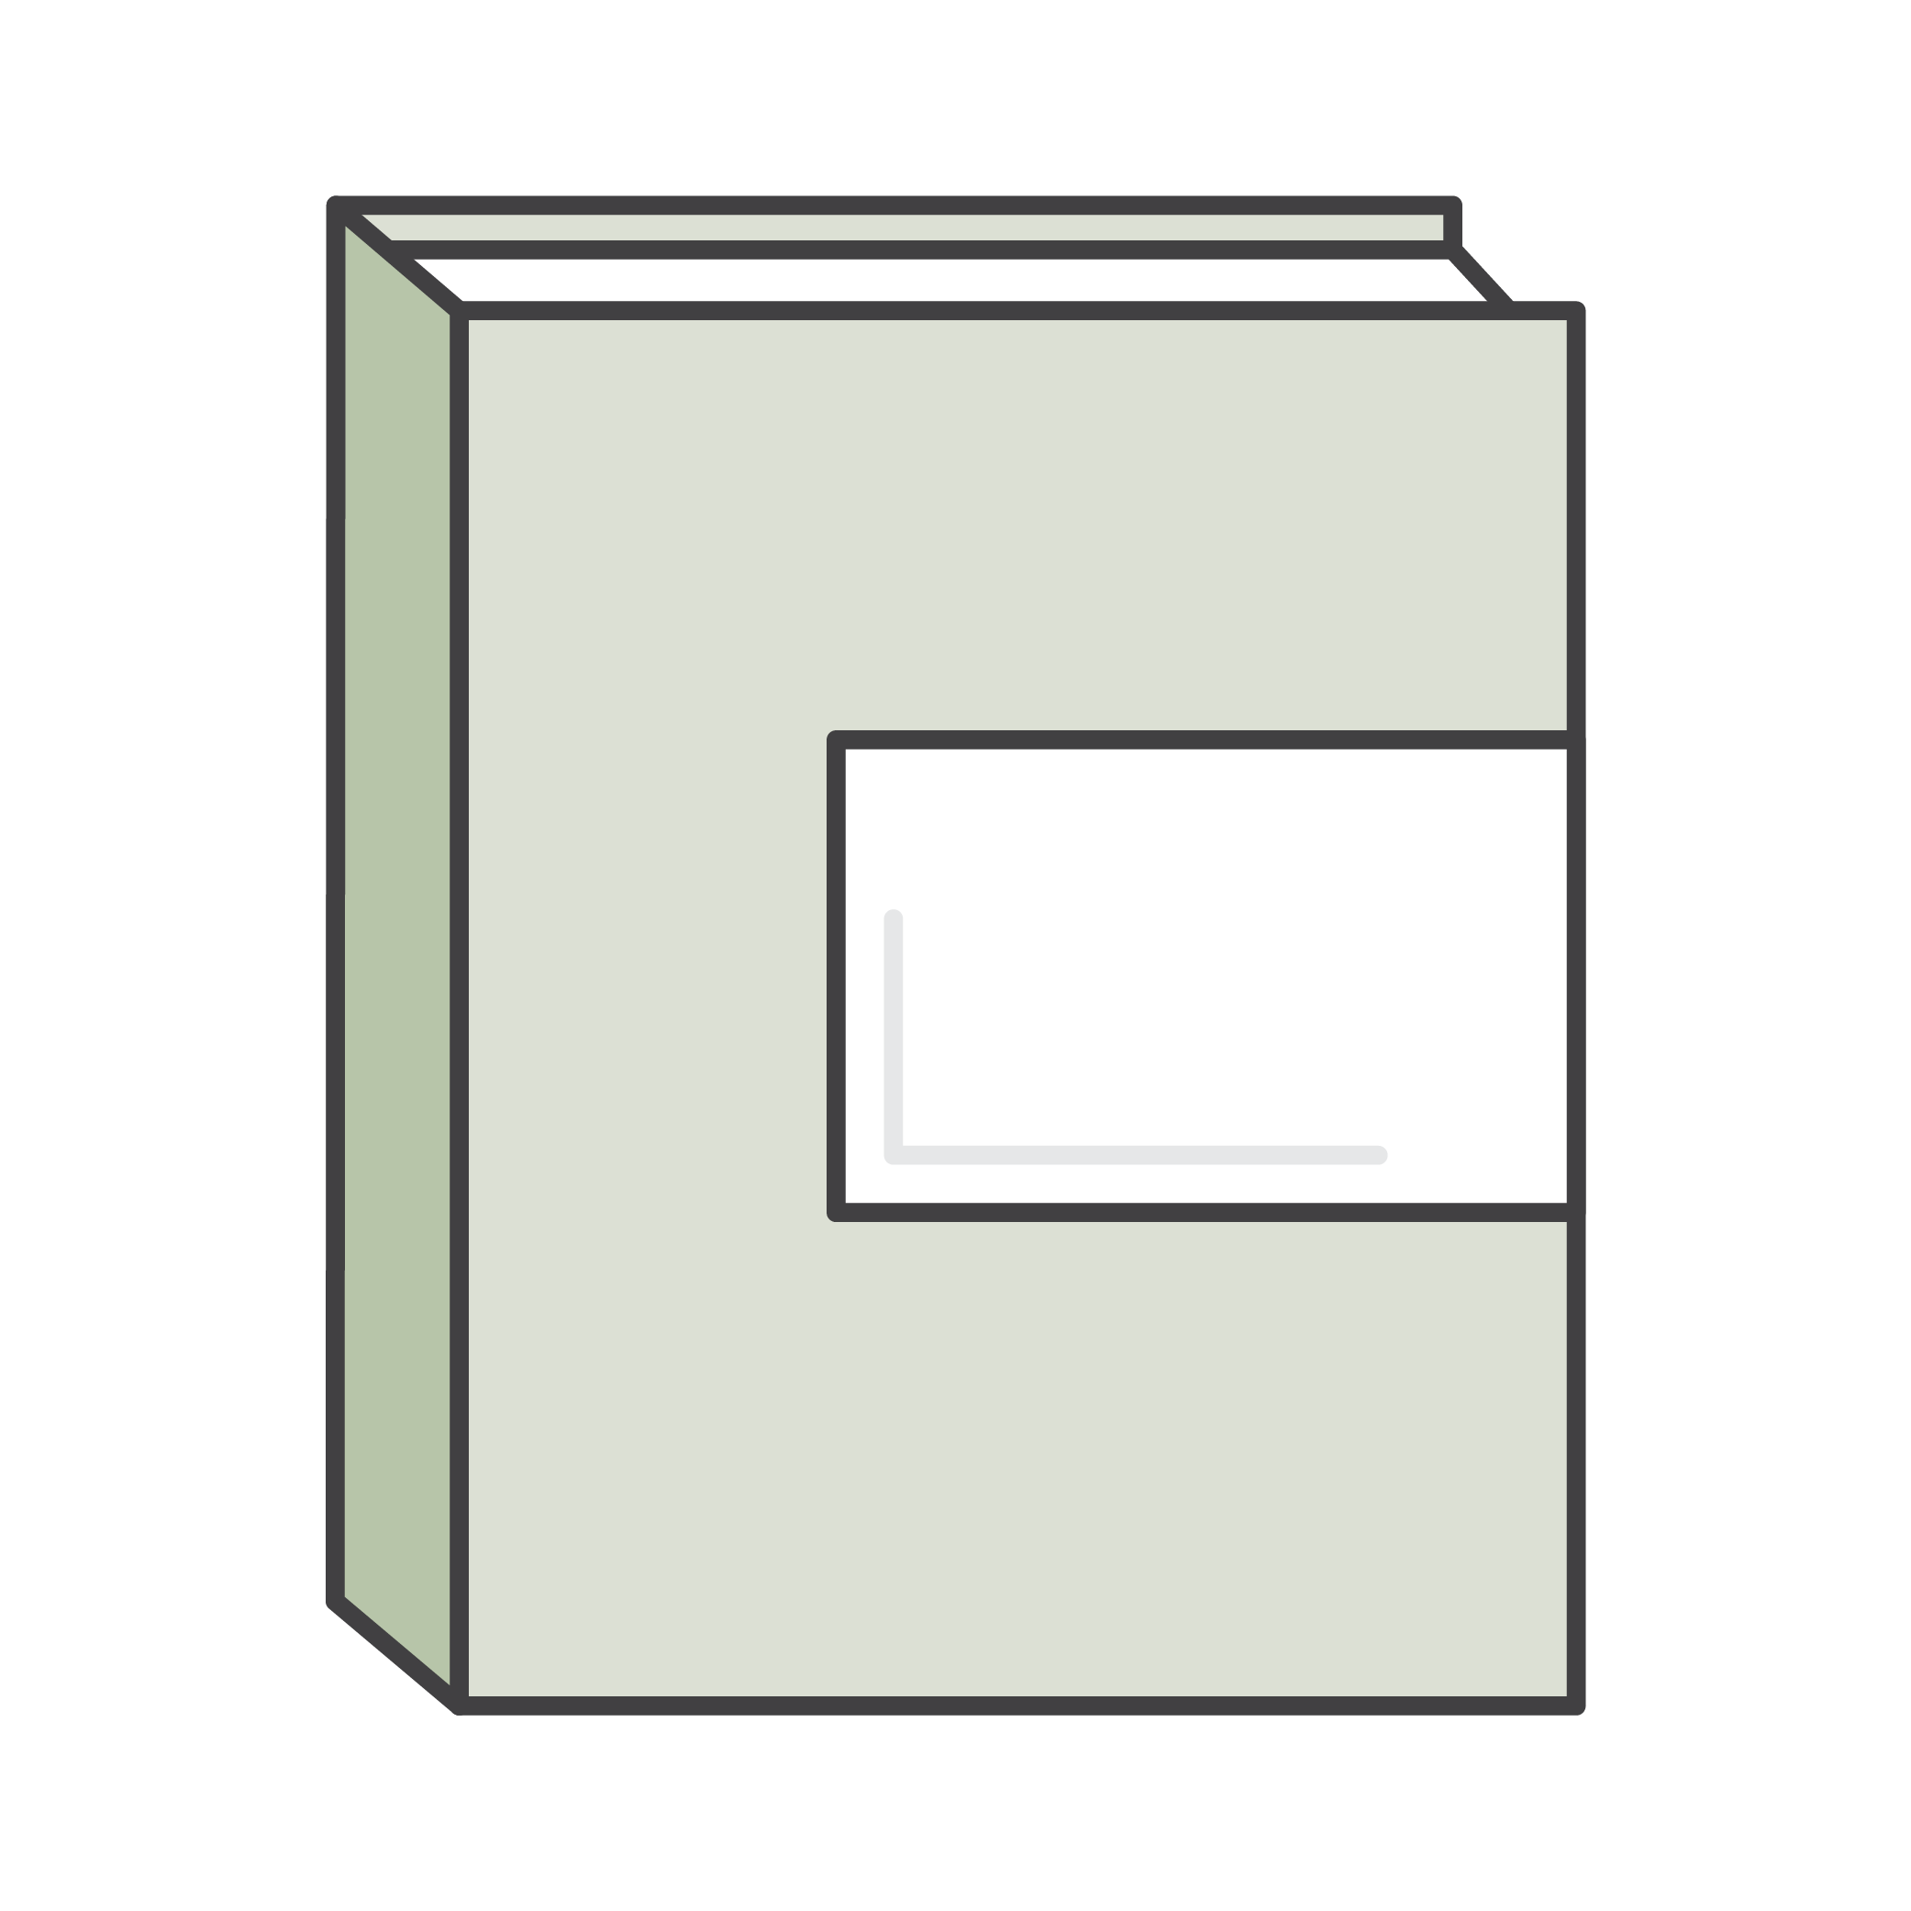

Course Objectives
During this course, you will be able to:
Make architectural decisions based on the AWS-recommended architectural principles and best practices.
Explore leveraging AWS services to make your infrastructure scalable, reliable, and highly available.
Leverage AWS managed services to enable greater flexibility and resiliency in an infrastructure.
Make an AWS-based infrastructure more efficient in order to increase performance and reduce costs.
Use the Well-Architected Framework to improve architectures with AWS solutions.
Notes:
During this course, you will be able to:
• Make architectural decisions based on the AWS-recommended architectural principles and best practices.
• Use AWS services to make an infrastructure scalable, reliable, and highly available.
• Use AWS managed services to enable greater flexibility and resiliency in an infrastructure.
• Make an AWS-based infrastructure more efficient in order to increase performance and reduce costs.
• Use the Well-Architected Framework to improve architectures with AWS solutions.

Slide 5

Course Overview
Module 0 (Optional): AWS Service Review
Module 1: Course Welcome and Overview
Module 2: Designing the Network
Module 3: Designing for High Availability – Section 1
Module 4: Designing for High Availability with Scaling – Section2
Module 5: Automating Your Infrastructure
Module 6: Decoupling Your Infrastructure
Module 7: Designing Web-Scale Media
Notes:
To achieve these objectives, you will explore the following topics:
Module 0 is optional. It was included for those who desire a review of cloud concepts and AWS
Module 1 shares a course overview.
Module 2 introduces how to design a virtual private cloud.
Module 3 shares the principles of designing for high availability.
Module 4 continues the discussion about high availability, and introduces the concept of scalability.
Module 5 discusses approaches for automating an infrastructure.
Module 6 shares approaches for decoupling an infrastructure.
Module 7 explores how to design web-scale storage.

Slide 6
Course Overview, Continued
Module 8: Well-Architected Framework
Module 9: Well-Architected Pillar 1 - Operational Excellence
Module 10: Well-Architected Pillar 2 - Security
Module 11: Well-Architected Pillar 3 - Reliability
Module 12: Well-Architected Pillar 4 - Performance Efficiency
Module 13: Well-Architected Pillar 5 - Cost-Optimization
Module 14: Troubleshooting
Module 15: Design Patterns and Sample Architectures
Notes:
As the course continues, it will explore the foundations of the AWS Well-Architected Framework. You will explore the following topics:
• Module 8 introduces the Well-Architected Framework.
• Module 9 discusses the Well-Architected Framework Pillar 1: Operational Excellence.
• Module 10 reviews the Well-Architected Framework Pillar 2: Security.
• Module 11 reviews the Well-Architected Framework Pillar 3: Reliability.
• Module 12 discusses the Well-Architected Framework Pillar 4: Performance Efficiency.
• Module 13 concludes the Well-Architected Framework discussion with Pillar 5: Cost-Optimization.
• Module 14 explores troubleshooting.
• Module 15 discusses design patterns and sample architectures.

Slide 7
Module 1: Course Welcome and Overview
Prerequisites
Course Objectives
Course Overview
Notes:
This module provides a course overview and reviews the course objectives.

Slide 8
Module 2: Designing the Network
Part 1: Choosing a Region
Part 2: Selecting Availability Zones
Part 3: Virtual Private Cloud (VPC)
Part 4: Dividing VPCs and Subnets
Part 5: Default VPCs and Default Subnets
Part 6: Controlling VPC Traffic
Part 7: Connecting Multiple VPCs
Part 8: Integrating On-Premises Components
Part 9: VPC Best Practices
Exercise: Improve this Architecture
Notes:
In parts 1, 2, and 3 of Module 2, you will learn how to choose a Region, select an Availability Zone, and create a virtual private cloud, or VPC. In parts 4 and 5, you will gain a further understanding of what VPCs and subnets are, including default VPCs and default subnets. Part 6 reviews how to control VPC traffic. Part 7 discusses how to connect multiple VPCs, and part 8 reveals how to integrate on-premises components. The module concludes with part 9, which is a review of best practices for VPCs. Part 9 also includes an exercise to improve an example architecture.

Slide 9
Module 3: Designing for High Availability
Section 1 – High Availability
Part 1: Load Balancing and Fault Tolerance
Exercise: Improve this Architecture
Part 2: High Availability Across Regions
Part 3: Connections Outside of AWS
Module 3 Lab: Making Your Environment Highly Available
Group Discussion: Forklift an Existing Application onto AWS
Notes:
In part 1 of Module 3, you will learn about load balancing and fault tolerance for high availability. Part 2 discusses how to achieve high availability across Regions. In part 3, you will learn how to connect to resources outside of your Amazon Virtual Private Cloud, or Amazon VPC. Module 3 also includes a lab - Making Your Environment Highly Available, which is a hands-on lab where you can gain experience with creating a highly available environment. You will conclude High Availability: Part 1 with a group discussion about how to move an existing application to the cloud.

Slide 10
Module 4: Designing for High Availability
Section 2 - Scaling
Part 1: Best Practice - Scalability
Part 2: Determining if Scaling is Needed
Part 3: Automatic Scaling
Exercise: Improve this Architecture
Part 4: Scaling Data Stores
Part 5: AWS Lambda and Event-Driven Scaling
Module 4 Lab: Using Notifications to Trigger AWS Lambda
Notes:
Module 4 is divided into five parts and a lab. In part 1, you learn about best practices for scaling. In part 2, you learn how to determine when you need to use scaling. Part 3 explores automatic scaling and its benefits. Part 3 includes Exercise 3, which gives you an opportunity to apply your knowledge of scaling to improve an example architecture. In part 4, you learn about scaling data stores, and part 5 discusses AWS Lambda and event-driven scaling. Finally, in the lab Using Notifications to Trigger AWS Lambda, you gain hands-on experience creating an Amazon Simple Notification Service (Amazon SNS) topic as a notification target for Auto Scaling events and then create an AWS Lambda function that is invoked when it receives the Amazon SNS topic that an autoscaling event has occurred.

Slide 11
Module 5 Details: Automating Your Infrastructure
Part 1: Manual environment configuration
Part 2: Infrastructure as code on AWS
Part 3: Grouping resources in a template
Part 4: Resources not supported by AWS CloudFormation
Module 5 Lab: Automating Infrastructure Deployment with AWS CloudFormation
Notes:
In Module 5, you will look at environments that are created manually. Design patterns for decoupling and the need for reducing the interdependencies between tiers are discussed. We’ll discover infrastructure as code on AWS. Next, you’ll group resources in a template. Best practices for using microservices and designing solutions with components are explained. Finally, you’ll gain insight into resources not supported by AWS CloudFormation. Complete this module with the lab where you will use AWS CloudFormation to deploy a VPC networking layer and deploy an application layer that references the networking layer. You will also explore templates with AWS CloudFormation Designer and delete a stack that has a Deletion Policy.

Slide 12
Module 6: Decoupling Your Infrastructure
Part 1: Loose Coupling
Part 2: Loose Coupling Strategies
Part 3: Communicating Easily and Reliably Between Components
Part 4: Communicating with Loose Coupling and Amazon DynamoDB
Part 5: Amazon API Gateway
Part 6: Serverless Architectures
Part 7: Decoupling Examples
Notes:
In parts 1 and 2 of Module 6, you will learn about the concept of loose coupling, and strategies for how to use loose coupling to improve your architecture. In part 3, you will learn how to communicate reliably between components. Part 4 addresses loose coupling with Amazon DynamoDB. In part 5, you will learn how to use Amazon API Gateway for loose coupling. Part 6 discusses creating serverless architectures with AWS Lambda. This module concludes with part 7, which covers several examples of several decoupling.

Slide 13
Module 7: Designing Web-Scale Media
Part 1: Storing Web-Accessible Content with Amazon S3
Part 2: Caching with Amazon CloudFront
Part 3: Managing NoSQL databases
Part 4: Storing Relational Data in Amazon RDS.
Module 7 Lab: Implementing a Serverless Architecture with AWS Managed Services
Group Discussion 2: Scalable Web Application
PROJECT 1 – A Medical Company – Designing a Cloud Solution
Notes:
In part 1 of Module 7, you will learn how to store web-accessible content with Amazon S3. Part 2 review caching with Amazon CloudFront. In part 3, you will explore the features of managing NoSQL databases. In part 4, you will learn how to store relational data in Amazon Relational Database Service, or Amazon RDS. You will conclude this module with a lab – Implementing a Serverless Architecture with AWS Managed Services and a Group Discussion that looks at building a scalable web application.
Following Module 7, Project 1 is introduced.

Slide 14
Module 8 Details: Design Patterns and Sample Architectures
Part 1: Introduction to the Well-Architected Framework
Part 2: Pillars of the Well-Architected Framework
Part 3: Well-Architected Design Principles
Notes:
Part 1 of Module 8 introduces you to the Well-Architected Framework. In part 2, you will learn about the five pillars of the Well-Architected Framework. Finally, in part 3, you will learn about the general design principles for the Well-Architected Framework.
To prepare for this module and the following modules, review the Well-Architected Framework whitepaper by going to the following page: https://d1.awsstatic.com/whitepapers/architecture/AWS_Well-Architected_Framework.pdf

Slide 15
Module 9: Well-Architected Framework Pillar 1 – Operational Excellence
Part 1: Principles of the Operational Excellence Pillar
Part 2: Drive Operational Excellence
Part 3: Operational Excellence Pillar Questions
Notes:
In part 1 of Module 9, you will learn about the principles of the Well-Architected Framework Operational Excellence pillar. Part 2 identifies several ways to drive operational excellence. In part 3, you will consider a series of questions about the Operational Excellence pillar, and learn some best practices that are relevant to each question.

Slide 16
Module 10: Well-Architected Framework Pillar 2 – Security
Part 1: Principles of the Security Pillar
Part 2: Preventing Common Security Exploits
Part 3: Securing Data in CloudFront
Part 4: Encrypting Data
Part 5: Authentication
Module 10 Lab: Introduction to Amazon CloudFront
Notes:
In part 1 of Module 10, you will learn about the principles of the Well-Architected Framework Security pillar. Part 2 covers how to prevent common security exploits, and part 3 discusses how to secure data in Amazon CloudFront. In part 4, you will learn about encrypting your data. In part 5, you will review best practices for authentication. This module concludes with a lab that introduces Amazon CloudFront.

Slide 17
Module 11: Well-Architected Framework Pillar 3 – Reliability
Part 1: Principles of the Reliability Pillar
Part 2: Making Your Infrastructure More Reliable
Exercise: Improve This Architecture
Module 11 Lab: Multi-Region Failover with Amazon Route 53
Part 3: Reliability Pillar Questions
Notes:
In part 1 of Module 11, you will learn about the principles of the Well-Architected Framework Reliability pillar. Part 2 discusses how to make your infrastructure more reliable. Next, you will work on an exercise to improve a sample architecture. Finally, Part 3 raises questions about reliability for you to consider, and provides some best practices that are relevant to each question.

Slide 18
Module 12: Well-Architected Framework Pillar 4 – Performance Efficiency
Part 1: Principles of the Performance Pillar
Part 2: Making Your Infrastructure Perform More Efficiently
Exercise: Improve This Architecture
Part 3 Performance Pillar Questions with Best Practices
Notes:
In part 1 of Module 12, you will learn about the principles of the Well-Architected Framework Performance pillar. Part 2 discusses ways to make your infrastructure perform more efficiently. In part 3, you will complete an exercise that focuses on improving a sample architecture. Finally, in part 4, you will review questions about performance, and learn about best practices that are relevant to each question.

Slide 19
Module 13: Well-Architected Framework Pillar 5 – Cost Optimization
Part 1: Principles of the Cost-Optimization Pillar
Part 2: Optimizing the Cost of Your Infrastructure
Part 3: Dedicated Instances and Dedicated Hosts
Part 4: Trusted Advisor
Part 5: Optimizing Cost with Caching
Part 6: AWS Cost Calculation Tools
Exercise: Improve this Architecture
Appendix A: Cost Optimization Questions
Notes:
In Part 1 of Module 13, you will learn about the principles of the Well-Architected Framework Cost Optimization pillar. Part 2 discusses how to optimize the cost of your infrastructure, and part 3 covers Dedicated Instances and Dedicated Hosts. In Part 4, you will learn about AWS Trusted Advisor, and how it can help you manage costs. Part 5 discusses how to optimize costs with caching, and part 6 explores several cost calculation tools. Finally, this module ends with an exercise to improve a sample architecture.

Slide 20
Module 14 Details: Troubleshooting
Part 1: Troubleshooting Steps to Take When Encountering Errors.
Part 2: Discover the various AWS Support Options Available.
Notes:
In part 1 of Module 14, you will learn about the troubleshooting steps that you can take when you encounter common errors. In part 2, you will explore the various options for AWS Support that are available.

Slide 21
Module 15: Design Patterns and Sample Architectures
Part 1: High Availability Design Patterns
Part 2: Stream Processing Example
Part 3: Sensor Network Data Ingestion and Processing Example
Part 4: Application Back-End Example
Part 5: Transcoding and Serving Video Files Example
PROJECT 2 – GoGreen Insurance Company – Designing a “Paperless” Solution
Notes:
Part 1 of Module 15 reviews several design patterns for high availability. In part 2, you will explore an example of stream processing. Part 3 reviews an example of sensor network data ingestion and processing. In part 4, you will learn about an example of an application backend. Finally, part 5 reviews an example of transcoding and serving video files.

Slide 22
Up Next: Unit 2 – Designing Your Environment
Notes:
Up next, you will start with Unit 2 that guides you through how architects design their Amazon Web Services, or AWS, environments. It also establishes guidelines and patterns for selecting AWS Regions, Availability Zones, Multi-Accounts, Multi-VPCs, and subnet structures. These concepts are conveyed through a mixture of recommendations, best practices, design patterns, and questions meant to be used by architects to determine the full requirements of their solutions.

Slide 23
Thanks for participating!
© 2019 Amazon Web Services, Inc. or its affiliates. All rights reserved. This work may not be reproduced or redistributed, in whole or in part, without prior written permission from Amazon Web Services, Inc. Commercial copying, lending, or selling is prohibited. Corrections or feedback on the course, please email us at: aws-course-feedback@amazon.com. For all other questions, contact us at: https://aws.amazon.com/contact-us/aws-training/. All trademarks are the property of their owners.

